Slide 1
“Transforming Our World Vs. Maintaining the Parish”
“Are Catholics Called to Tithe?”
2016 Spring Stewardship Education Meeting

Slide 2
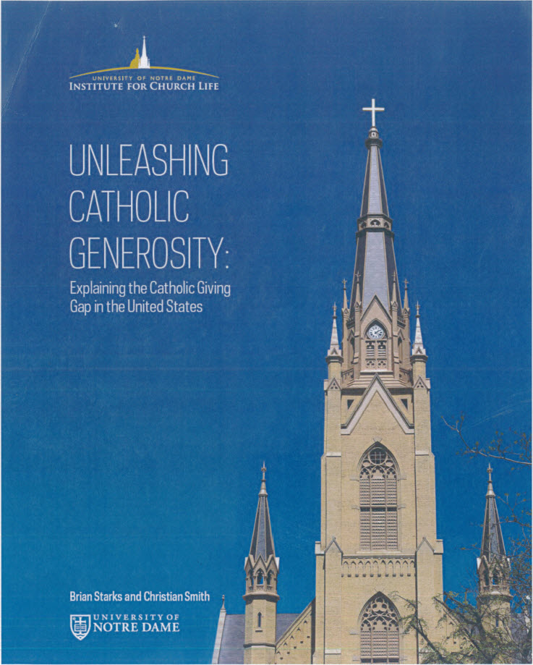
Notes:
Tonight we will focus on the importance of giving gifts of treasure and help you answer the question, “Are Catholics Called to Tithe?” As mentioned earlier, we will share with you a beautiful, thought-provoking homily by our very own, Fr. Jonathan Meyer, but before that we will highlight for you insights gleaned from a recent research study called “Unleashing Catholic Generosity” by Brian Starks and Christian Smith from the University of Notre Dame.

Slide 3
“Catholic generosity has the potential
to reshape our world,
as it has reshaped many lives,
but it will do so only
if we learn how
to cultivate compassionate Catholics
and generous parishes
and to nurture cultures
conducive to giving.”
~ Brian Starks
Notes:
One of the co-researchers, Brian Starks, made the above statement……………..

Slide 4
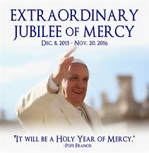
Notes:
The Year of Mercy is an invitation—an invitation to love, kindness, and unbounded generosity. Pope Francis is offering us the opportunity to encounter the incredible mercy of God.

Slide 5
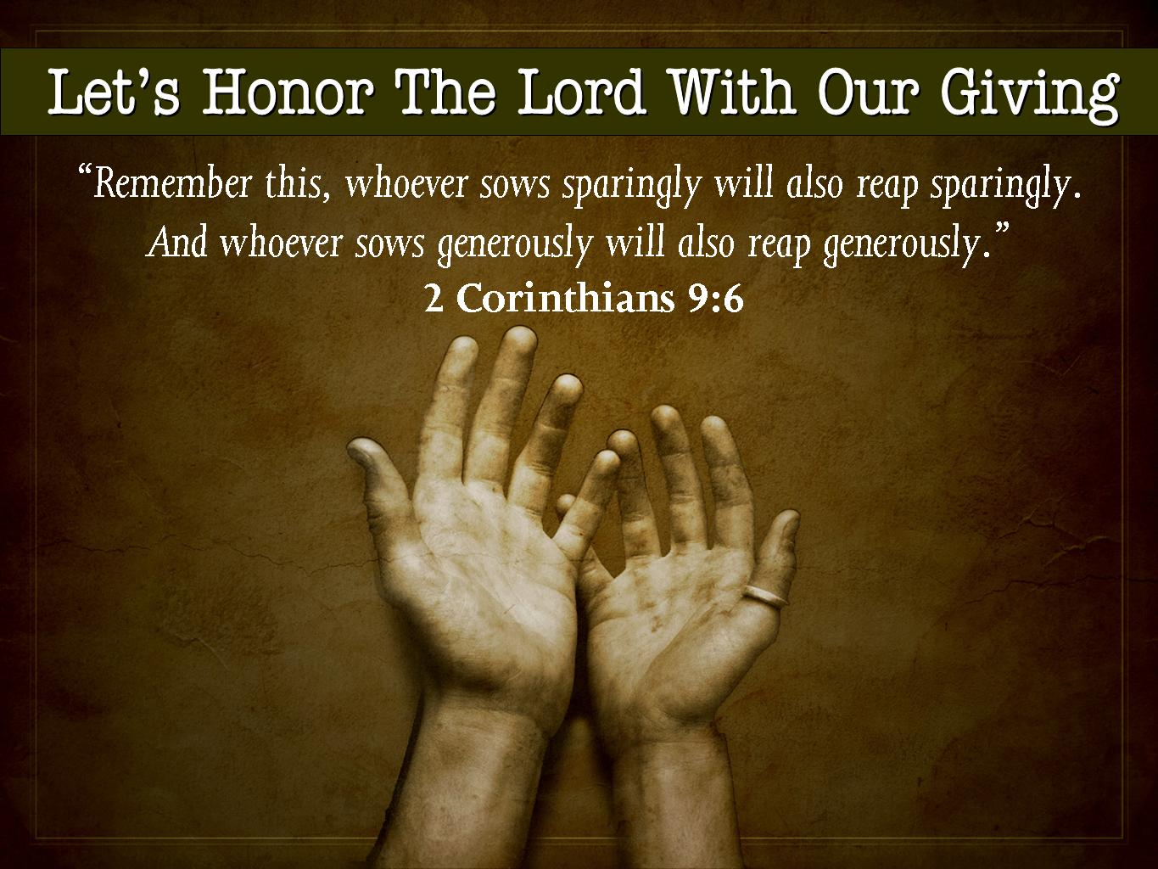

Slide 6
“Unleashing Catholic Generosity” findings:
American Catholics are less likely than the rest of the population to report giving 10 percent or more of their income as voluntary contributions.
Notes:
Two men were marooned on an Island. One man paced back and forth worried and scared while the other man sat back and was sunning himself. The first man said to the second man, "aren’t you afraid we are about to die." "No," said the second man, "I make $100,000 a week and tithe faithfully to my church every week. My Pastor will find me."

Slide 7
“Unleashing Catholic Generosity” findings continued:
Catholics are less likely to report giving money to the Church, with only 20% reporting that they donate to religious causes. Roughly 40% did not donate to any charitable cause, religious or otherwise.
Notes:
Two men were marooned on an Island. One man paced back and forth worried and scared while the other man sat back and was sunning himself. The first man said to the second man, "aren’t you afraid we are about to die." "No," said the second man, "I make $100,000 a week and tithe faithfully to my church every week. My Pastor will find me."

Slide 8
“Unleashing Catholic Generosity” findings continued:
The single most important factor explaining the giving gap is a lack of “spiritual engagement with money” on the part of most American Catholics.
Notes:
Two men were marooned on an Island. One man paced back and forth worried and scared while the other man sat back and was sunning himself. The first man said to the second man, "aren’t you afraid we are about to die." "No," said the second man, "I make $100,000 a week and tithe faithfully to my church every week. My Pastor will find me."

Slide 9
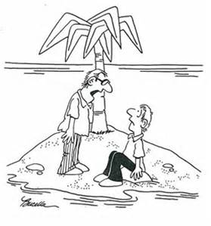
Two men were marooned on an island. One man paced back and forth worried and scared while the other man sat back and was sunning himself. The first man said to the second man, "aren’t you afraid we are about to die."
"No," said the second man, "I make $100,000 a week and tithe faithfully to my church every week.
My Pastor will find me."

Slide 10
“Unleashing Catholic Generosity” findings continued:
American Catholics tend to compartmentalize; they tend to separate money from matters of faith and to think that money or material possessions have little to do with spiritual or religious issues.
Notes:
4. Instead of seeing money as ultimately God’s, and therefore viewing themselves as stewards called to use money faithfully to fulfill Christian purposes, Catholics tend to view money and material possessions as having little or nothing to do with religious or spiritual issues.
5. The report goes on to say, “Some ways of discussing money in parishes tend to be unhelpful. A “pay the bills” culture that focuses on the parish’s need and scarcity (as opposed to spiritual growth and world transformation) is associated with less spiritual engagement with money … and consequently, with less financial giving.”
6. Parish culture should help us (Catholics) reflect on the dangers of compartmentalizing their financial dealings from their life of faith.

Slide 11
“Unleashing Catholic Generosity” findings continued:
The largest gaps in giving exist among regular church attenders.
Notes:
4. Instead of seeing money as ultimately God’s, and therefore viewing themselves as stewards called to use money faithfully to fulfill Christian purposes, Catholics tend to view money and material possessions as having little or nothing to do with religious or spiritual issues.
5. The report goes on to say, “Some ways of discussing money in parishes tend to be unhelpful. A “pay the bills” culture that focuses on the parish’s need and scarcity (as opposed to spiritual growth and world transformation) is associated with less spiritual engagement with money … and consequently, with less financial giving.”
6. Parish culture should help us (Catholics) reflect on the dangers of compartmentalizing their financial dealings from their life of faith.

Slide 12
“Unleashing Catholic Generosity” findings continued:
Discussions of money in Catholic parishes should not center on meeting basic organizational needs, but rather on spiritual growth and personal and world transformation. In other words, “paying the bills” vs. “living the vision”.
Notes:
4. Instead of seeing money as ultimately God’s, and therefore viewing themselves as stewards called to use money faithfully to fulfill Christian purposes, Catholics tend to view money and material possessions as having little or nothing to do with religious or spiritual issues.
5. The report goes on to say, “Some ways of discussing money in parishes tend to be unhelpful. A “pay the bills” culture that focuses on the parish’s need and scarcity (as opposed to spiritual growth and world transformation) is associated with less spiritual engagement with money … and consequently, with less financial giving.”
6. Parish culture should help us (Catholics) reflect on the dangers of compartmentalizing their financial dealings from their life of faith.

Slide 13
“Unleashing Catholic Generosity” findings continued:
Discussion of money should be brought up within the larger context of a parish mission and vision.
Notes:
Such discussions will be especially beneficial if parishioners gain a clear understanding that an active and growing spiritual life requires Catholics to recognize money and possessions as gifts of grace, which they are called to manage and share as good stewards. Unfortunately, Catholic parishioners, compared with members of American faiths currently report a lack of communication regarding the mission and vision of their parish…. To grow and sustain a supportive parish community, your parishioners must be informed about the ministries that are vital to your mission and how those are supported through their offering. This reminds me of a question we’ve asked you often in recent years, “What are your 3GT’s – your three great things? visionhsyour u
Parish leaders will benefit from the development of (collaborative) parish cultures in which service and mission inspire a vision of opportunities for charitable giving that can dramatically improve the Church, change people’s lives and transform our world. As we discussed last year in our “Generations of Faith” series, this holds especially true for our younger generations. Though they are turned off by “money talks mentality” that diminishes them to only someone who can give money, they are inspired by opportunities to change the world.

Slide 14
“Unleashing Catholic Generosity” findings continued:
When parishioners understand themselves to be a part of the planning and vision of their parish, and when they become excited about all of the good things that donated money can accomplish, this empowers them and engenders a sense of ownership, all of which leads to more generous giving.
Notes:
Such discussions will be especially beneficial if parishioners gain a clear understanding that an active and growing spiritual life requires Catholics to recognize money and possessions as gifts of grace, which they are called to manage and share as good stewards. Unfortunately, Catholic parishioners, compared with members of American faiths currently report a lack of communication regarding the mission and vision of their parish…. To grow and sustain a supportive parish community, your parishioners must be informed about the ministries that are vital to your mission and how those are supported through their offering. This reminds me of a question we’ve asked you often in recent years, “What are your 3GT’s – your three great things? visionhsyour u
Parish leaders will benefit from the development of (collaborative) parish cultures in which service and mission inspire a vision of opportunities for charitable giving that can dramatically improve the Church, change people’s lives and transform our world. As we discussed last year in our “Generations of Faith” series, this holds especially true for our younger generations. Though they are turned off by “money talks mentality” that diminishes them to only someone who can give money, they are inspired by opportunities to change the world.

Slide 15
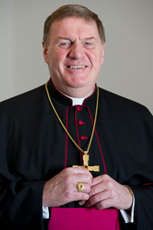
“People have an underdeveloped sense of stewardship and that limited spirituality is what people use to make decisions. Your faith is not a spectator sport – you must be engaged.
What are your first fruits?
Do you view your church as deserving of your first fruits?”
~Archbishop Joseph Tobin

Slide 16
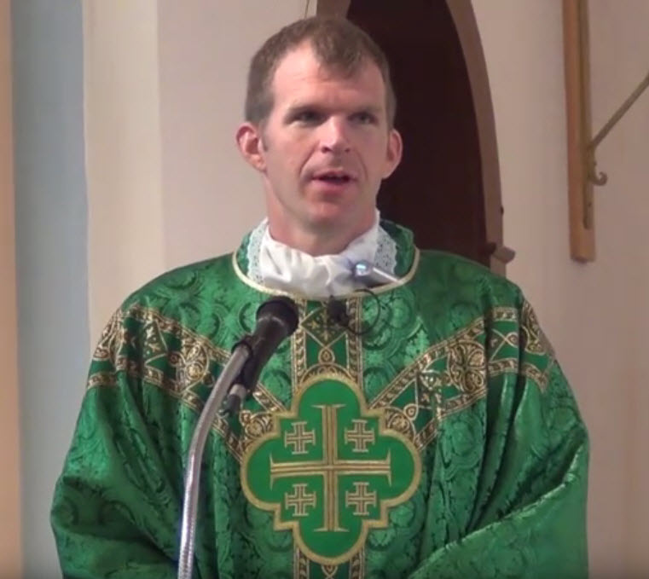
Homily
Fr. Jonathan Meyer,
October 11th, 2015

Slide 17
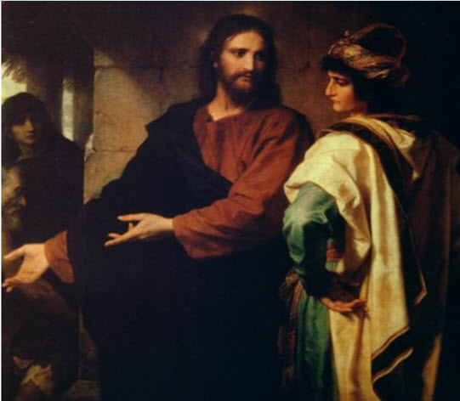
and the rich young man went away sad.

Slide 18
The Rich Man
¹⁷ As he was setting out on a journey, a man ran up and knelt before him, and asked him, “Good Teacher, what must I do to inherit eternal life?” ¹⁸ Jesus said to him, “Why do you call me good? No one is good but God alone. ¹⁹ You know the commandments: ‘You shall not murder; You shall not commit adultery; You shall not steal; You shall not bear false witness; You shall not defraud; Honor your father and mother.’” ²⁰ He said to him, “Teacher, I have kept all these since my youth.” ²¹ Jesus, looking at him, loved him and said, “You lack one thing; go, sell what you own, and give the money to the poor, and you will have treasure in heaven; then come, follow me.” ²² When he heard this, he was shocked and went away grieving, for he had many possessions.
²³ Then Jesus looked around and said to his disciples, “How hard it will be for those who have wealth to enter the kingdom of God!” ²⁴ And the disciples were perplexed at these words. But Jesus said to them again, “Children, how hard it is to enter the kingdom of God! ²⁵ It is easier for a camel to go through the eye of a needle than for someone who is rich to enter the kingdom of God.” ²⁶ They were greatly astounded and said to one another, “Then who can be saved?” ²⁷ Jesus looked at them and said, “For mortals it is impossible, but not for God; for God all things are possible.”
New Revised Standard Version Catholic Edition

Slide 19
Small Group Questions #1
Fr. Meyer said, “The rich and the wealthy don’t go to heaven,” and “We’re called to love God above all of our possessions”.
What did you personally take away from Fr. Meyer’s homily?
Did you feel prompted by God in any way to give up some added portion of your “possessions”?
In today’s world, do you believe tithing 10% can be thought of as a useful benchmark for generous financial giving?
How could your parish be impacted by what you learned?

Slide 20
Small Group Questions #2
“Rather than simply replacing spiritual vision with a secular business model of financial legitimacy, our research suggests that parish leaders will benefit from the development of collaborative parish cultures in which service and mission inspire a vision of opportunities for charitable giving that can dramatically improve the Church and change people’s lives and the world.”
Does your parish have a unique mission and vision?
Do your parishioners believe in this mission and vision?
Are there ways your parish can better communicate it’s mission and vision? Why is this important?

Slide 21
Small Group Questions #3
Fr. Andrew Kimberling who wrote “Making Stewardship a Way of Life” says, “Get rid of fundraisers. Needs based giving ends with a false conclusion – I don’t need to give any more. Needs based giving nullifies the very essence of who we are – our need to give. Fundraising kills the collection. When, at our parish, we take care of everything else via a charity account, where $1 of $10 goes, then giving is Eucharistic, precious and holy. Then, spiritually, our gift is united with the Body and Blood of Jesus.”
What do you think about Fr. Kimberling’s view of parish fundraising?
Has this been considered in your parish?

Slide 22
Small Group Questions #4
The Stewardship Education Director for the Archdiocese of St. Louis, Dave Baranowski, answers the question, “How do we get our pastors/PLC’s to talk about giving one time a month?”, by encouraging them to say, “Thank you for your offertory giving of $___ last month. We were able to do……”
Would this be a way for your parish to move your mission forward?
What other ways could you do this?

Slide 23
Next Steps?
What did we learn tonight? What are our practical takeaway ideas?
If you would like this presentation to be made at your Parish Council, Stewardship or Finance Committees, etc., please feel free to contact Ron Greulich at rgreulich@archindy.org or (317) 236-1426

